Slide 1
Lead Scoring Case Study
By
Deepak Prakash Raj
Tanu Shri Pant

Slide 2
Problem Statement
X Education markets its online courses for professionals on several websites and Google.
People who visit the website and provide their contact information are classified as a lead.
Though the company gets a lot of leads, the conversion rate is pretty low (about 30%)

Slide 3
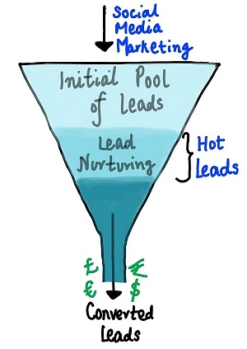
Lead Conversion Process-Demonstrated as a Funnel
There are a lot of leads generated at the top but only a few of them come out as paying customers from the bottom.
In the middle level we need to constantly nurture the potential leads well (educating about the product, constantly communicating) in order to get higher lead conversion.

Slide 4
Task at hand
Selection of the most promising leads i.e. the leads that are more likely to convert to promising customers.
Create a model where we need to assign a lead score to each of the leads such that the customer with a higher lead score have a higher conversion chance.

Slide 5
The Data Set
A leads dataset with around 9000 points has been provided.
The dataset consists of various attributes such as Lead Source, Total Time Spent on Website, Total Visits, Last Activity etc. has been provided.
The target column is ‘Converted’ which tells whether the past lead was converted or not.

Slide 6
Exploratory Data Analysis
First things first, we start with EDA.
The dataset contained several values as ‘Select’ which in terms of the dataset meant that the customer has avoided to fill for that field.
Thus these values are as good as null values so we decided to convert those to nan.

Slide 7
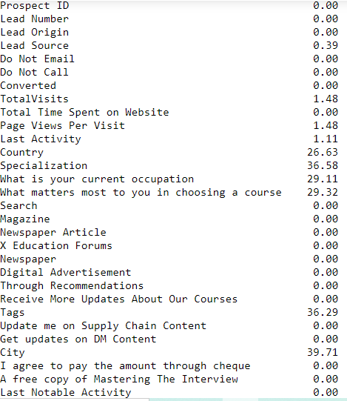
Cleaning the Dataset
We calculated the percentage
of null values in the dataset.
Dropped the columns which
contained more than 40% of null values.
We can still see columns having null
Values, for that we use imputation in
the next step.

Slide 8
Imputation using mode
Going through the columns we see that most of the leads captured are from Country ‘India’.
So we decided to replace the nan values for column ‘Country’ with India and make one category for other countries.

Slide 9
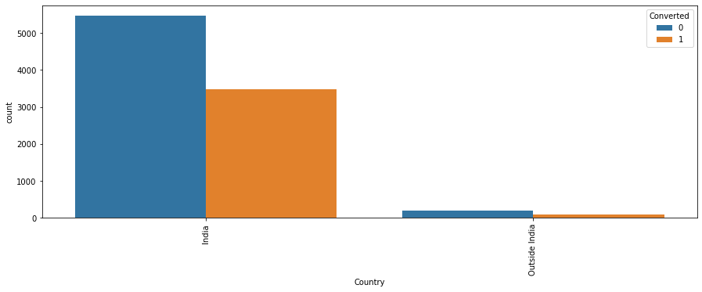
Plot of Country Vs Lead Count
We see 97% of the data values are from India, so it is better to drop ‘Country’ column.

Slide 10
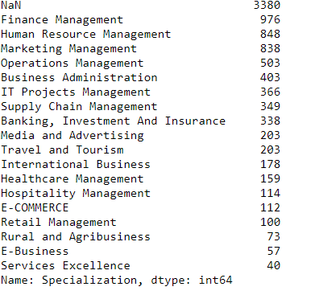
Looking at Specialization
- The Dataset contained several specializations.
- We replaced the NaN specialization with ‘Not Specified’ and combined Management related specializations into one.

Slide 11
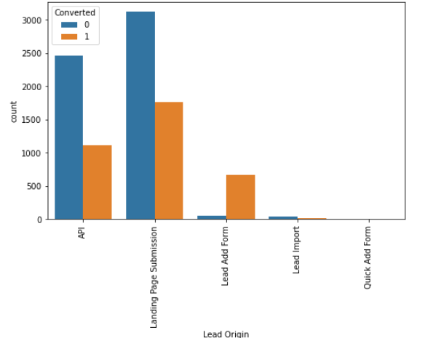
Lead Origin and Count
Inferences
1. API and Landing Page Submission bring higher number of leads as well as conversion.
2. Lead Add Form has a very high conversion rate but count of leads are not very high.
3. Lead Import and Quick Add Form get very few leads

Slide 12
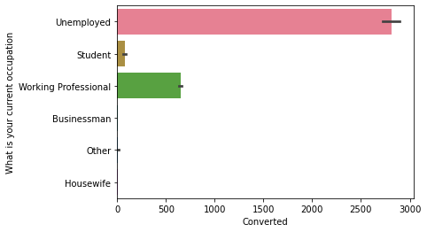
Occupation Analysis
Most people enquiring about the course are Unemployed

Slide 13
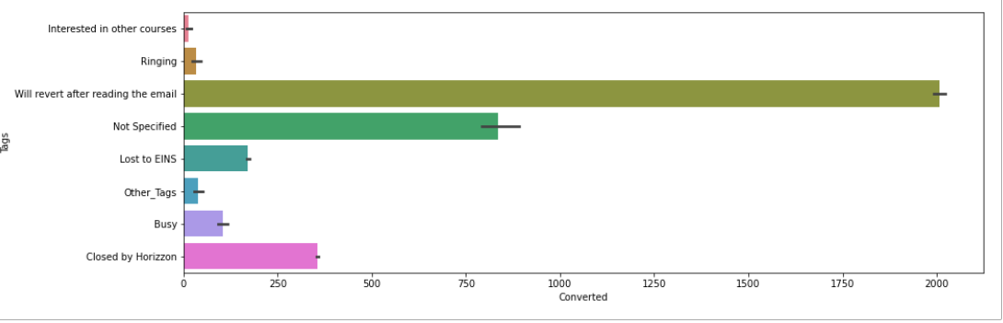
The Tags Column
Imputed the Tags column with Mode and replaced low frequency values with ‘Other Tags’
We see that most people revert after reading the email.

Slide 14
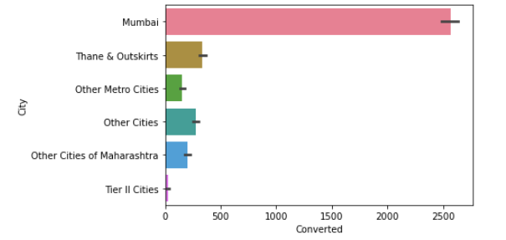
City Column
Most people were from Mumbai so imputed the NaN with ‘Mumbai’.

Slide 15
Other Columns
Replaced low frequency column with ‘Others’ and ‘Facebook’ with Social Media.
In the ‘Last Activity’ column replaced low frequency values with ‘Others’.
Imputed median values for columns ‘Total Visits’ and ‘Page Views Per visit’.
ALL NULL VALUES CLEARED. DATA CLEANED!

Slide 16
Outlier Treatment
Removed top 2% and bottom 2% values for column ‘Total Visits’ .
Removed top 1% and bottom 1% for ‘Pages per visit’ column.

Slide 17
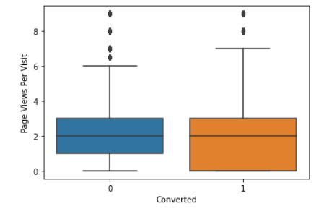
Numerical Variable analysis
Median for converted and non converted leads is same.

Slide 18
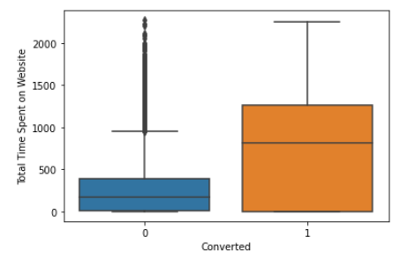
"Total Time Spent on Website" vs Converted variable
Inference
Website should be made more engaging as Leads spending more time on the website are more likely to be converted, so as to make leads spend more time.

Slide 19
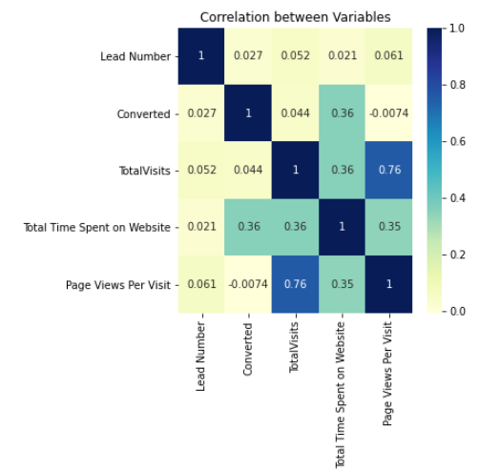
Checking Correlation
Time spent on website and page views per visit are highly correlated.

Slide 20
Creation of Dummy Variables
Changed 'A free copy of Mastering The Interview' & 'Do Not Email' to be changed to 0 1
Created dummy variables for Lead Origin, What is your current occupation, City, Specialization, Lead Source, Tags, Last Activity, Last Notable Activity

Slide 21
Model Building
The train and test data split in the ratio 70% and 30%.
After that scaling of data is performed using Standard Scalar.
RFE performed on the columns and selected top 18 variables
Trained the logistic regression model using GLM.
Checked the VIF(Variance Inflation Factor) of the variables and found that it was well under control(under 5)

Slide 22

Predicting values on Train Set
Assigned ‘1’ to predicted column if churn_probability > 0.5 else 0.
Created the Confusion matrix.
Overall Accuracy: 92.8%

Slide 23
Model Evaluation
Sensitivity / Recall: Percentage of actual converted identified.
TPR = TP/TP+FN = 87.87%
Specificity: Percentage of non converted correctly identified.
TNR = TN/TN+FP = 95.87%
Precision : Percentage that a predicted Converted has actually converted
FPR = TP/TP+FP = 92.7%

Slide 24
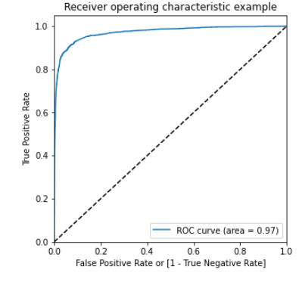
ROC Curve
An ROC curve demonstrates several things:
It shows the tradeoff between sensitivity and specificity (any increase in sensitivity will be accompanied by a decrease in specificity).
2. The closer the curve follows the left-hand border and then the top border of the ROC space, the more accurate the test.
3. The closer the curve comes to the 45-degree diagonal of the ROC space, the less accurate the test.

Slide 25
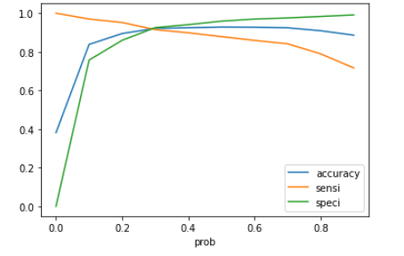
Finding Optimal Cutoff
Optimal cutoff probability is that prob where we get balanced sensitivity and specificity
Accuracy, Sensitivity, Specificity plot for various Probabilities
From the curve above, 0.3 is the optimum point to take it as a cutoff probability.

Slide 26
Evaluation matrices
Sensitivity/ Recall : TP/TP+FN = 91.48%
Specificity: TN/TN+FP = 92.54%
Precision: TP/FP+TP = 88.33%

Slide 27

Predictions on the Test Set
Sensitivity = 91.17%
Specificity = 93.45%
Precision = 89.89%
Recall = 91.17%

